Slide 1

Physical Activity and Health Promotion
Costanzo Giulio Moretti
Unit of Endocrinology
Università di Roma TorVergata
St John Calibita Hospital Tiber Island Rome
Section of Reproductive Endocrinology

Slide 2
Lesson 4
Reproductive Endocrinology

Slide 3
https://www.endocrinologiamoretti.it

Slide 4
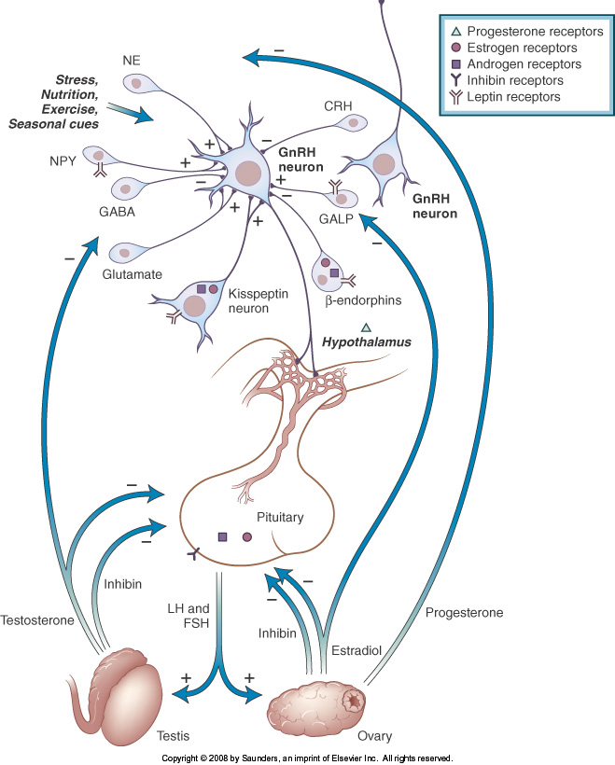
Notes:
Endocrine regulation of the Hypothalamic Pituitary Gonadal axis

Slide 5
Hormone-secreting cell types of the anterior pituitary
Anterior pituitary cell type | Hormone secreted | Size (number of amino acids) | Target organ | Hypothalamic regulator (+ or − effect)
Somatotroph | Growth hormone (GH) | 191 | Diverse | GH-releasing hormone (GHRH, +) and Somatostatin (SS, −)
Lactotroph | Prolactin (PRL) | 199 | Breast | Dopamine (−) and thyrotrophin-releasing hormone (TRH, +)
Corticotroph | Adrenocorticotrophic hormone (ACTH) | 39 | Adrenal cortex | Corticotrophin-releasing hormone(CRH, +)
Thyrotroph | Thyroid-stimulating hormone (TSH) | 204 | Thyroid | TRH (+) Somatostatin (SS, -)
Gonadotroph | Follicle-stimulating hormone (FSH) and luteinizing hormone(LH) | Both 204 | Ovary or testis | Gonadotrophin-releasing hormone(GnRH, +)

Slide 6
Reproductive development in utero can be broken down into two processes: sex determination, whereby the bipotential gonad becomes either the testis or ovary; and sex differentiation, the male or female phenotype that unfolds according to the presence or absence of male hormones from the testis. Both are remarkable for normally showing complete dimorphism, i.e. one or the other but not both, without which our species would be a reproductive failure.

Slide 7
The early development of sexual phenotype
At fertilization:
• Spermatozoan with either an X or a Y chromosome determines sex by fusing with an X-bearing ovum
At ~4 weeks of development
• Proliferation of cells in the urogenital ridge creates the bipotential gonad
At ~7 weeks of gestation (sex determination)
46,XY gonad becomes a testis
46,XX gonad remains as an ovary

Slide 8
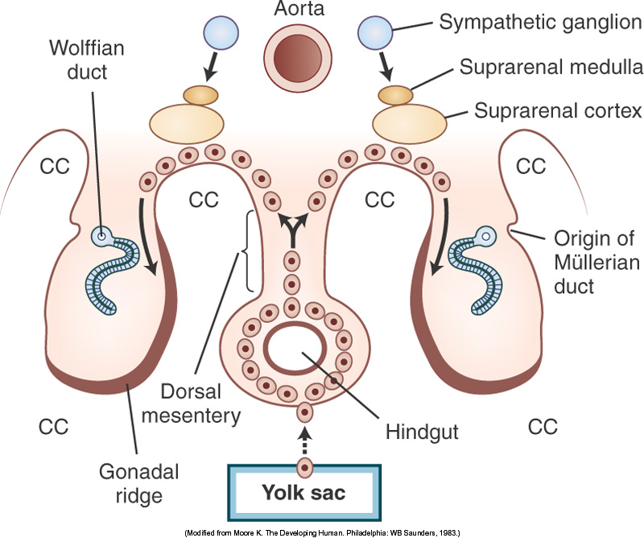
Notes:
Future gonadal function also relies on germ cells generating either spermatozoa or ova. Prior to and during sex determination, primordial germ cells migrate from the wall of the yolk sac through the gut mesentery into the gonad. In males, the formation of Sertoli cells within testicular cords induces mitotic arrest in germ cells. In females, proliferation, some atresia and, ultimately, entrance into the first stage of meiosis over the next few weeks determines the total number of ova for reproductive life.

Slide 9
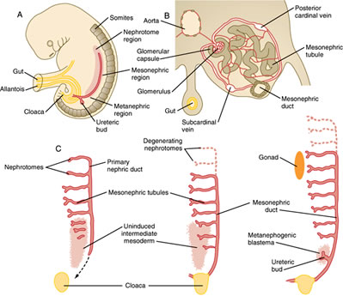
Embryology of the reproductive organs
Notes:
The urogenital system arises from intermediate mesoderm which forms a urogenital ridge on either side of the aorta. The urogenital ridge develops into three sets of tubular nephric structures (from head to tail): the pronephros, the mesonephros, and the metanephros. A. The Pronephros Is the cranialmost set of tubes, which mostly regress B. The mesonephros Is located along the midsection of the embryo and develops into mesonephric tubules and the mesonephric duct (Wolffian duct).
These tubules carry out some kidney function at first, but then many of the tubules regress. However, the mesonephric duct persists and opens to the cloaca at the tail of the embryo. C. The metanephros Gives rise to the definitive adult kidney. Develops from an outgrowth of the caudal mesonephric duct, the ureteric bud, and from a condensation of nearby renogenic intermediate mesoderm, the metanephric blastema.

Slide 10
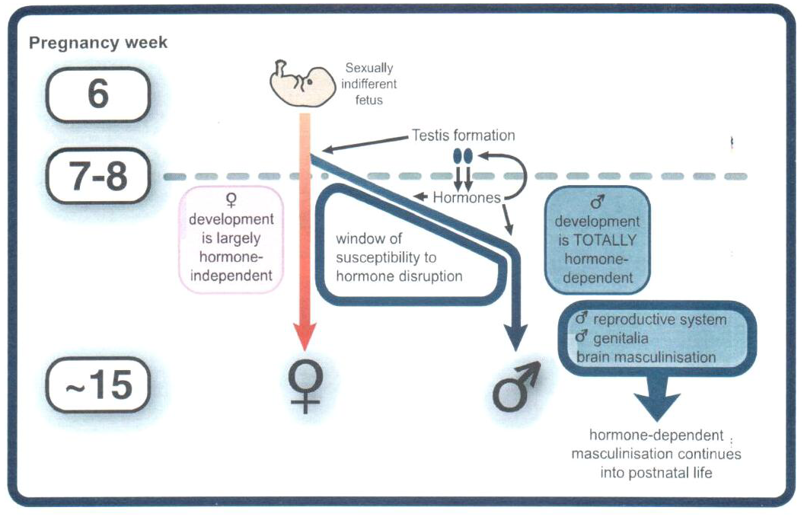
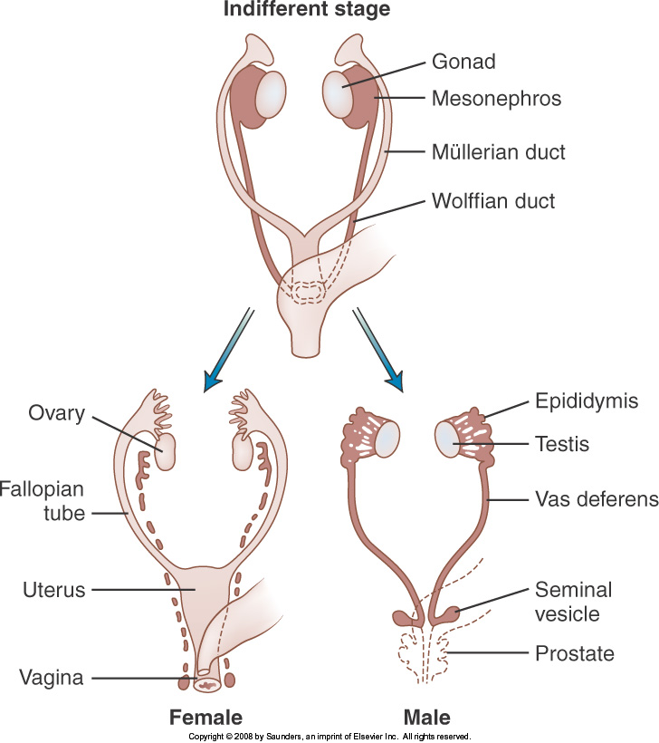
Notes:
Sex determination and sexual differentiation. In the human embryo the primordial germ cells migrate via the gut mesentery to the developing gonads. The appearance of the Wolffian and Müllerian ducts at ~6 weeks with germ cells invade the bipotential gonad. In the male (testis), seminiferous tubules differentiate and contain spermatogonia and Sertoli cells with Leydig cells interspersed between the tubules. The Müllerian duct regresses. In the female (ovary), primordial follicles develop and the Wolffian duct regresses.

Slide 11
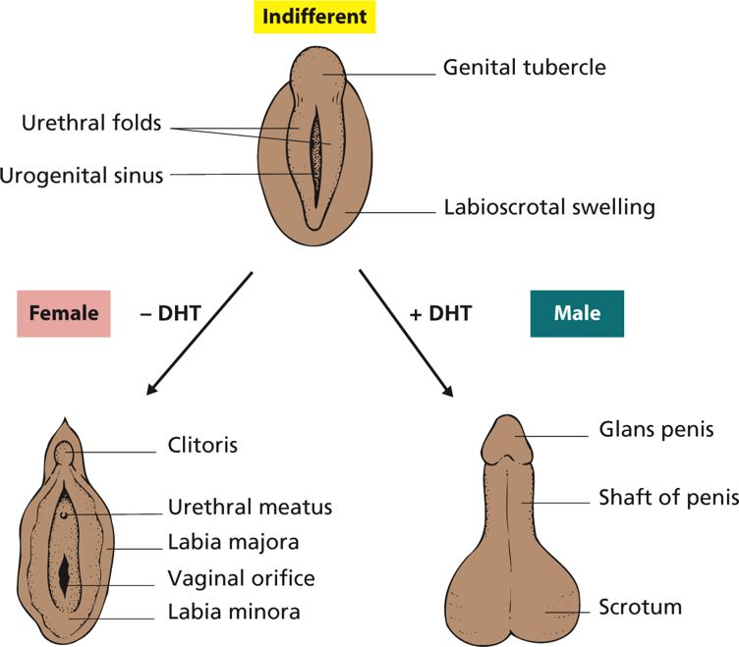
Notes:
In the female, relative lack of androgen lessens growth of the genital tubercle as the clitoris and retains patency between the urethral and labioscrotal folds as a vaginal opening flanked by the labia minora and majora

Slide 12
Disorders of sex development
46,XY Complete gonadal dysgenesis
• Complete failure of testis formation
• Severe loss-of-function mutations in SRY and other genes
46,XY Disorder of sex development
• Failure of testicular determination (e.g. loss-of-function mutation in SRY)
• Failure of steroidogenesis (mutation inactivating enzyme in biosynthetic pathway to testosterone)
• Failure of DHT biosynthesis (mutation in SRD5A2)
• Androgen insensitivity (mutation in the gene encoding the androgen receptor)
• Maternal consumption of anti-androgenic drugs (e.g. spironolactone)
46,XX Disorder of sex development
• Congenital adrenal hyperplasia (CAH) due to 21-hydroxylase deficiency (see Figure 6.10)
• Maternal androgen excess (e.g. androgensecreting tumour or anabolic steroid abuse)
Sex chromosome abnormalities
• Turner syndrome (45,XO)
• Klinefelter syndrome (47,XXY)

Slide 13
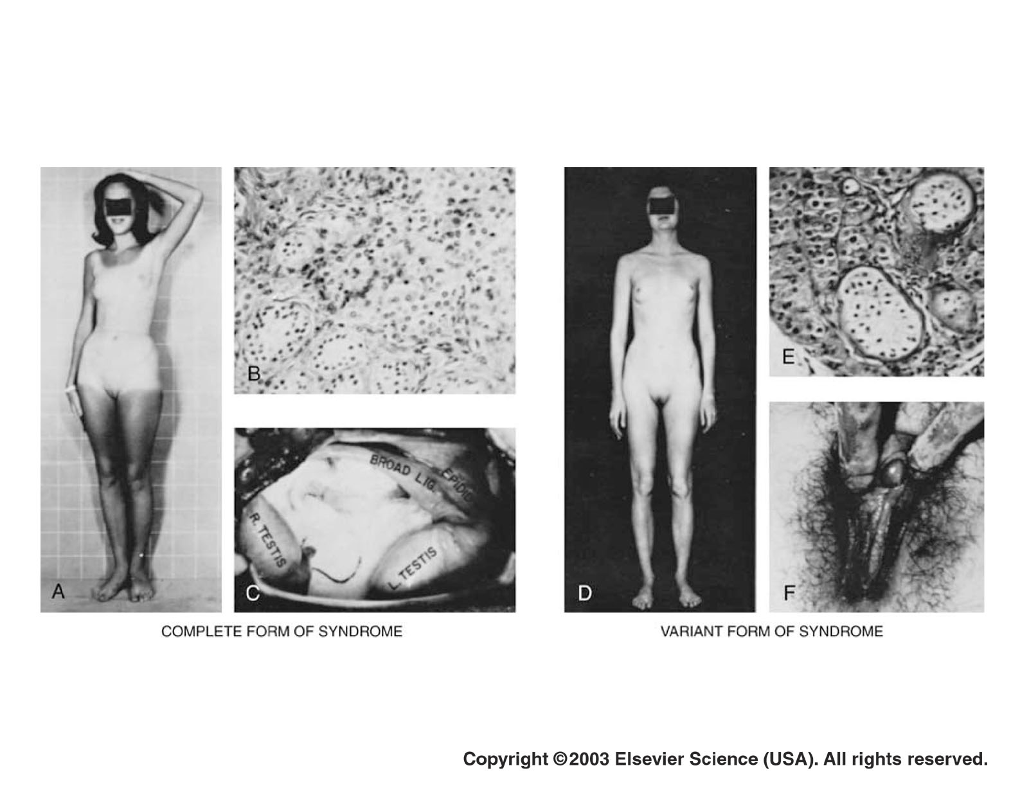

Slide 14
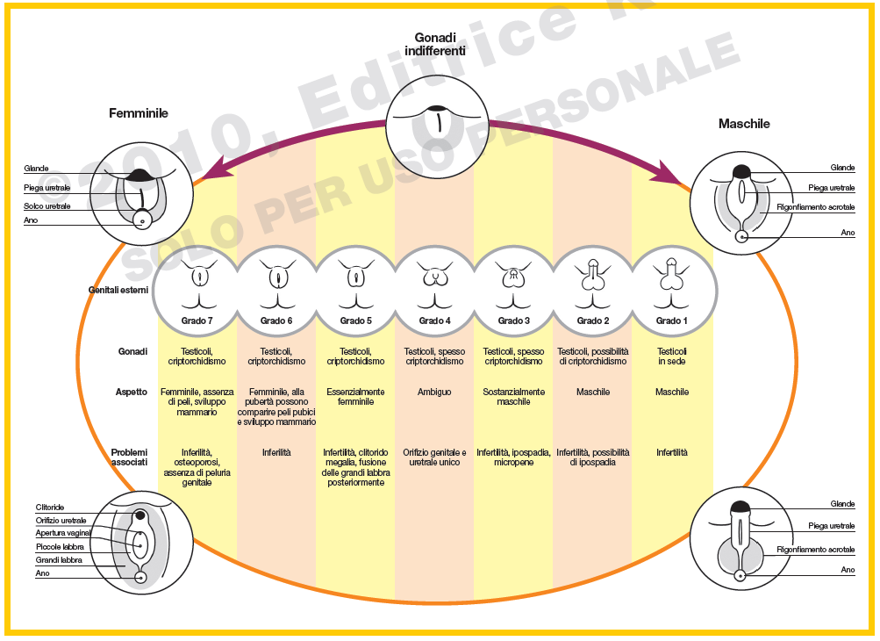

Slide 15
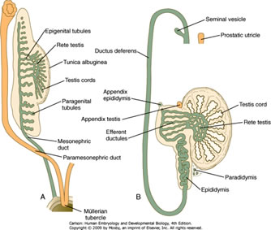
The male reproductive system
Notes:
In the testis two compartments exist: sperm-producing seminiferous tubules that develop from the testicular cords, largely determining testicular volume and requiring an operating temperature in the scrotum a few degrees below that of the body’s core; and an interspersed interstitium containing lipid-laden, steroidogenic Leydig cells. The seminiferous tubules contain the germ cells and the Sertoli cells (Figure 7.6). Tight junctions between adjacent Sertoli cells produce two compartments: a basal compartment with spermatogonia (self-renewing stem cells), and an adluminal compartment for the spermatocytes, spermatids and spermatozoa. The tubules of each testis lead via the rete testis to the epididymis, where maturation of the spermatozoa occurs, and on to the vas deferens.

Slide 16
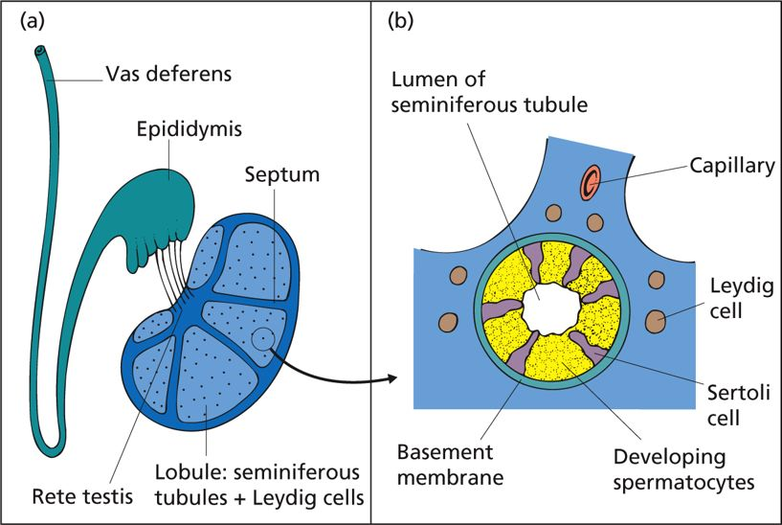
Notes:
A testis in cross-section. (a) The testis is organized into lobules containing Leydig cells and seminiferous tubules, which drain into efferent ducts and, via the rete testis, into the epididymis. The circle in (a) is shown at higher magnification in (b). (b) The organization of the seminiferous tubules and the interstitial Leydig cells.

Slide 17
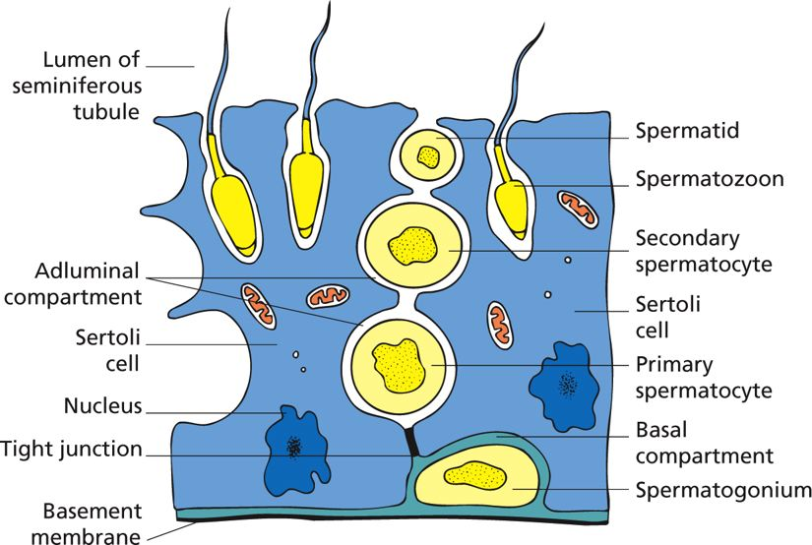
The structure of the seminiferous tubule
Notes:
The structure of the seminiferous tubule. Sertoli cells span the thickness of the tubule from basement membrane to central lumen. Tight junctions between adjacent Sertoli cells separate the spermatogonial stem cells in the basal compartment from the later stages of spermatogenesis in the adluminal compartment. The primordial germ cells that invade the embryonic gonad enter mitotic arrest as spermatogonia until puberty, after which they become reactivated by hormones (see following section on puberty). During mitosis, the basal spermatogonial stem cell renews itself and gives rise to a diploid daughter cell (the primary spermatocyte) that moves into the adluminal compartment. Primary spermatocytes then undergo the first meiotic division to form haploid secondary spermatocytes (review. The second meiotic division produces spermatids, which gradually mature into spermatozoa. An intimate association with the Sertoli (‘nurse’) cells is essential for this process. The spermatozoa are extruded into the lumen of the tubule and pass to the epididymis, following which they become mixed with the secretions of the seminal vesicles, prostate and bulbourethral glands at the time of ejaculation. Volumetric and microscopic analysis of the semen is an important part of assessing clinical testicular function because normal measurements strongly imply physiological follicle-stimulating hormone (FSH) and androgen secretion, and anatomical integrity (see next sections). Semen analysis can be part of investigating hypogonadism or subfertility.

Slide 18
Semen analysis (WHO standards)
It is a critical to investigation of infertility
• Very useful bioassay for normal testicular function
• Standards within 60 min of ejaculation: ◦ Volume > 2.0mL (usually 2–6mL) ◦ pH 7.2–8.0 ◦ Concentration > 20 million/mL ◦ Total sperm count > 40 million ◦ Morphology > 30% normal forms ◦ Motility > 50% with forward progression (or >25% with rapid progression) ◦ Vitality > 75% ◦ White blood cells < 1 million/mL
• Useful clinical terms: ◦
Normozoospermia: normal as defined above ◦
Oligozoospermia: spermatozoa present but <20 million/mL ◦
Azoospermia: no spermatozoa in ejaculate ◦
Aspermia: no ejaculate

Slide 19
Androgen biosynthesis in the Leydig cell follows the same path by which cholesterol is converted to the weak androgen, androstenedione, in the adrenal cortex. However, in the testis, the additional presence of type 3 17β-hydroxysteroid dehydrogenase (HSD17B3) generates the potent androgen, testosterone. The testis is the major site of androgen synthesis, with only a small contribution (<5%) by the adrenal. Testosterone acts in its own right as a potent androgen hormone binding the androgen receptor (AR), virilizing the internal genitalia and acting anabolically on muscle cells. It is also required in high local concentration for normal numbers of fully motile, mature spermatozoa (one reason why spermatogenesis is not restored in men taking exogenous testosterone replacement for hypogonadism). In other target tissues the action of the microsomal enzyme 5α-reductase (SRD5A) forms the more potent DHT. There are two isoforms of SRD5A, type 1 (SRD5A1) and type 2 (SRD5A2) encoded by different genes. SRD5A2 functions in the external genitalia and prostate. DHT binds with greater affinity than testosterone to the AR. The DHT-AR complex then mediates androgen action by regulating the transcription of downstream target genes. As well as forming DHT, testosterone may also be aromatized by the cytochrome P450 enzyme, CYP19, to oestradiol in target cells; or, alternatively, metabolized to degradation products that are excreted in the urine. The conversion of testosterone to oestradiol is important for normal bone health in men.

Slide 20
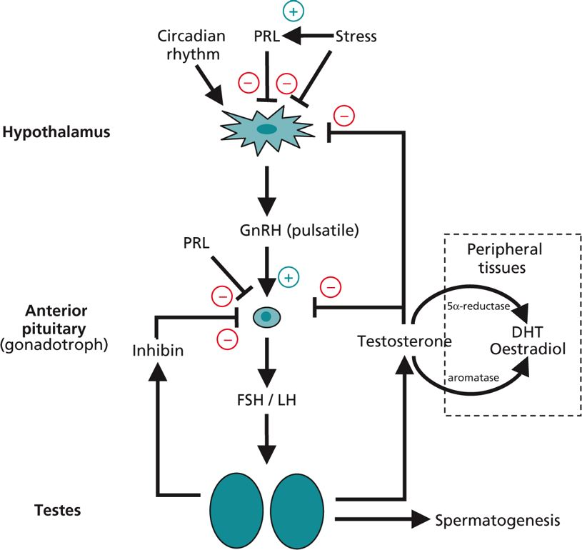
Notes:
The hypothalamic-anterior pituitary-testicular axis. Negative feedback at the gonadotroph and hypothalamus is complex and involves: 5α-dihydrotestosterone (DHT) and testosterone on luteinizing hormone (LH); and inhibin, testosterone and oestrogen on follicle-stimulating hormone (FSH). Prolactin (PRL) exerts a negative influence on gonadotrophin release, probably via altering gonadotrophin-releasing hormone (GnRH) pulsatility and action. Stress inhibits GnRH release and action at least in part by stimulating PRL.

Slide 21
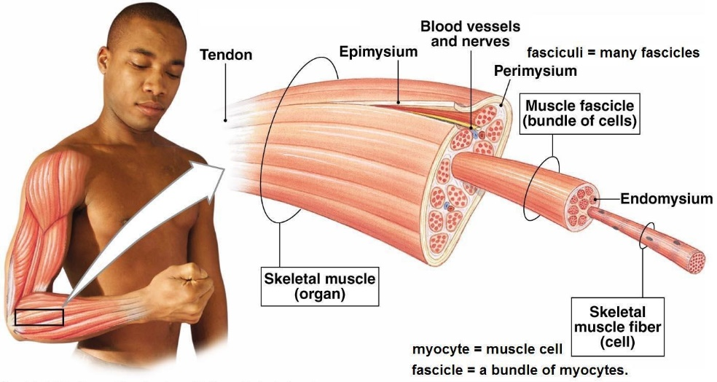
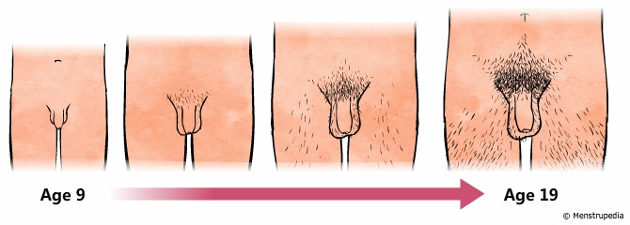
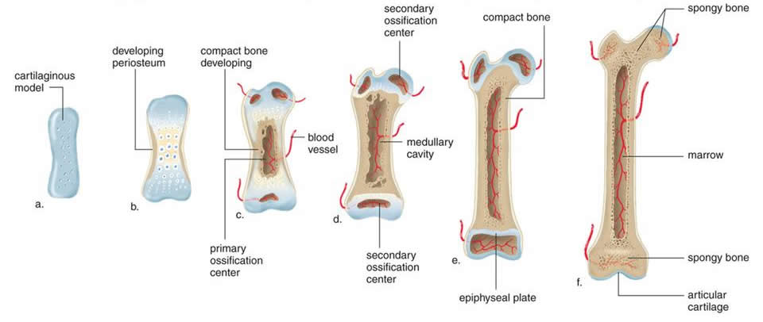
The effects of rising androgens at puberty
Skeletal muscle growth
Lengthening and development of the larynx/deepening of the voice
Pubic hair and beard growth
Sebaceous gland activity and odorous sweat
Thickened and pigmented skin over external genitalia
Increased size of the prostate, seminal vesicles and epididymis
Epiphyseal fusion and termination of linear growth

Slide 22
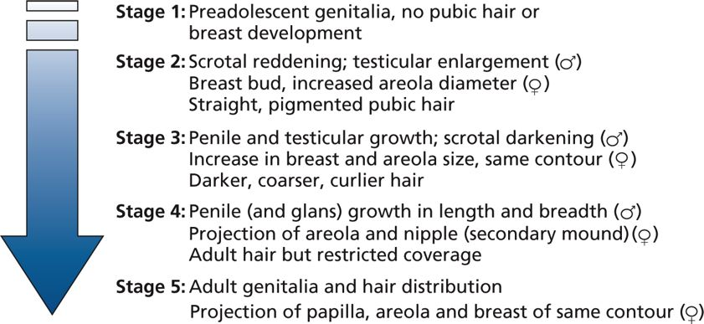
The stages of pubertal development in males and females as defined by Tanner

Slide 23
Clinical features of male hypogonadism
Post-puberty
• Loss of libido
• Subfertility/abnormal semen analysis
• Decreased muscle mass and exercise tolerance; tiredness
• Decreased shaving frequency
• Smooth skin, loss of pubic hair
• Small, soft testes, possibly not fully descended into scrotum
• Gynaecomastia
• Decreased bone mineralization, e.g. osteoporosis or osteopaenia
At (or dating back to) puberty
• Failure of voice to deepen
• Failure of testicular enlargement and penile growth
• Lack of scrotal pigmentation
• Eunuchoidism (arm span > height)
• Delayed bone age

Slide 24
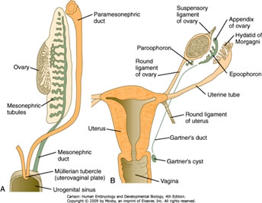
The female reproductive system

Slide 25
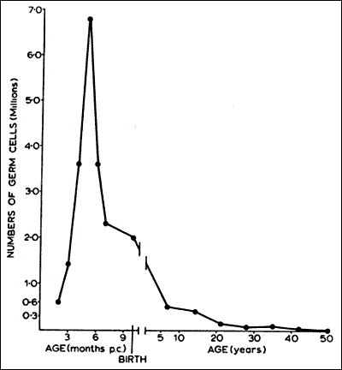
Ovarian morphology and function Oogenesis begins in the fetal ovary when, towards the end of the first trimester, germ cells start entering the first stage of meiosis and arrest in prophase. Termed primary oocytes, they are surrounded by a layer of steroid-producing granulosa cells as primordial follicles. There are ~6–7 million primordial follicles at 20 weeks of gestation, after which their number declines inexorably. At birth, there are ~2 million and by puberty only 300,000. Menopause marks the depletion of all germ cells within the ovaries.

Slide 26
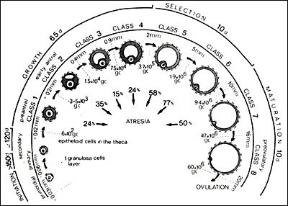

Slide 27
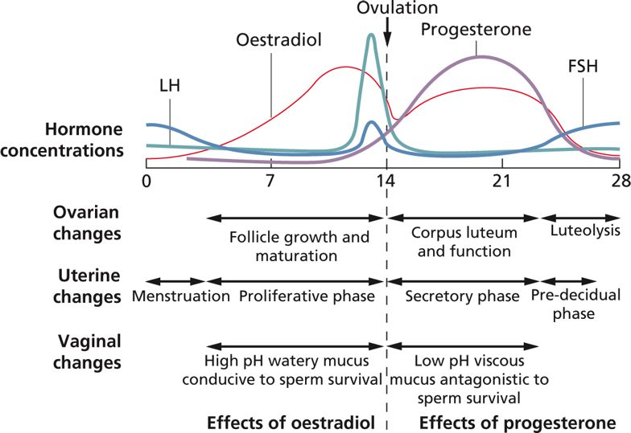
Notes:
The most potent oestrogen in humans is oestradiol. Its biosynthesis relies on two somatic cell types within the developing follicle, the inner theca cells (theca interna) that synthesize testosterone, which is then aromatized by CYP19 (also called aromatase) to oestradiol in the granulosa cell. Oestrogen can also be generated by CYP19 acting on androstenedione to form oestrone that can be converted to oestradiol by HSD17B1. Progesterone biosynthesis is relatively straightforward. Removal of the cholesterol side chain generates pregnenolone in theca cells, which is converted to progesterone by HSD3B activity.

Slide 28
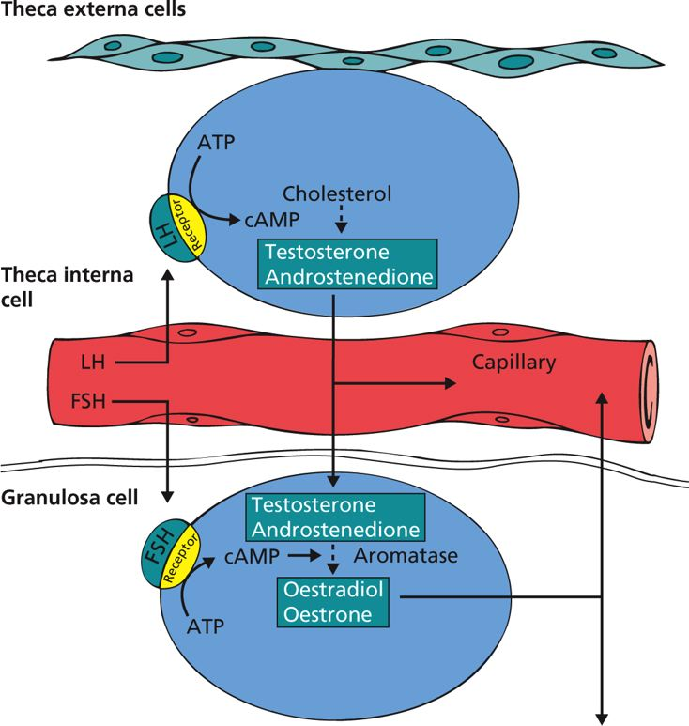
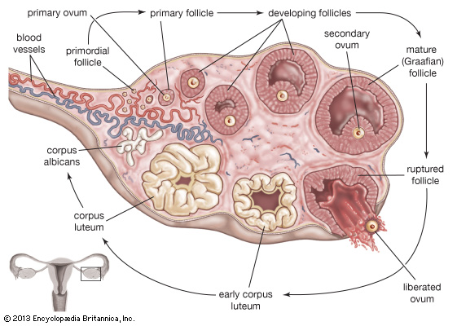
The ovarian function
Notes:
The two-cell biosynthesis of oestrogens. Luteinizing hormone (LH) stimulates its receptor on the theca interna cells and, via cAMP, leads to androstenedione and testosterone synthesis. These either pass into the local capillaries or cross the basement membrane into the adjacent granulosa cells. The granulosa cells are stimulated by follicle-stimulating hormone (FSH) to aromatize testosterone and androstenedione to oestradiol and oestrone, respectively, via the action of CYP19. These female hormones enter the circulation or pass into the antrum of the follicle and act on the oocyte. LH, luteinizing hormone; FSH, follicle-stimulating hormone.

Slide 29
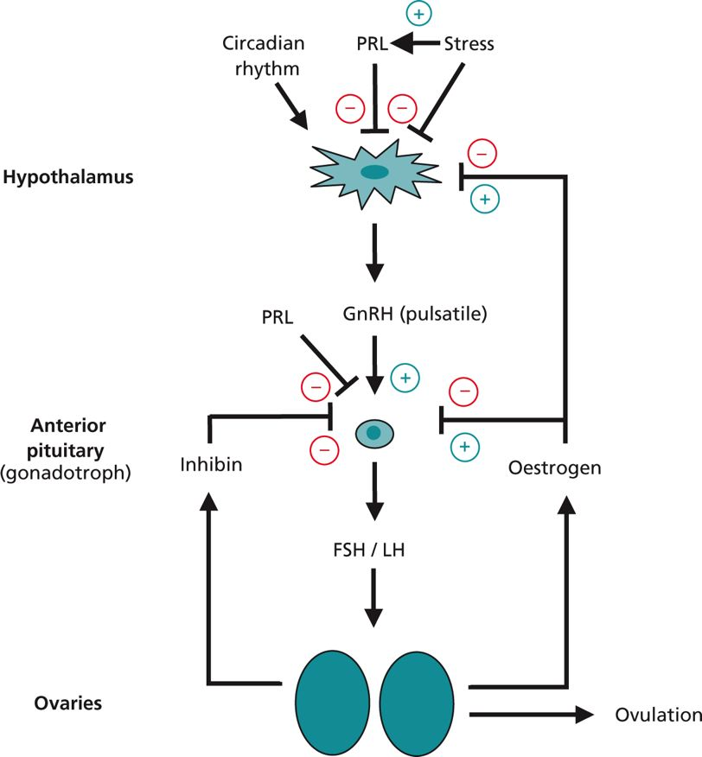
Notes:
The hypothalamic-anterior pituitary-ovarian axis. Note the variable negative and positive feedback. PRL, prolactin; GnRH, gonadotrophin-releasing hormone; LH, luteinizing hormone; FSH, follicle-stimulating hormone.

Slide 30
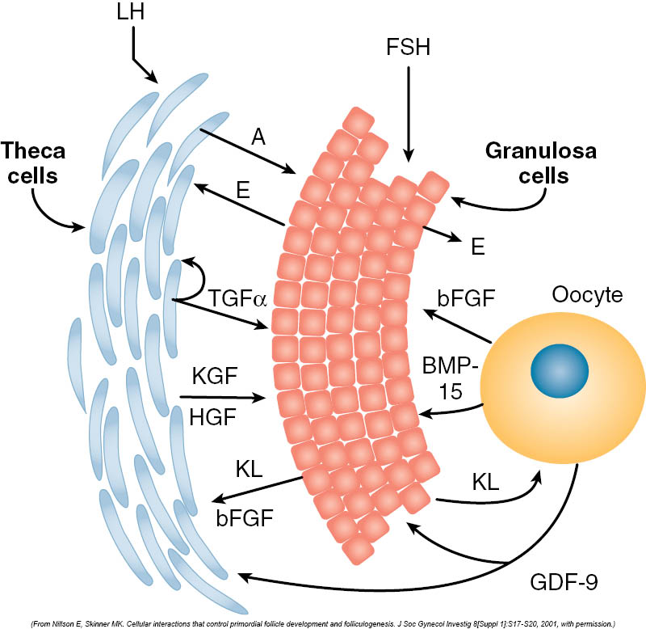
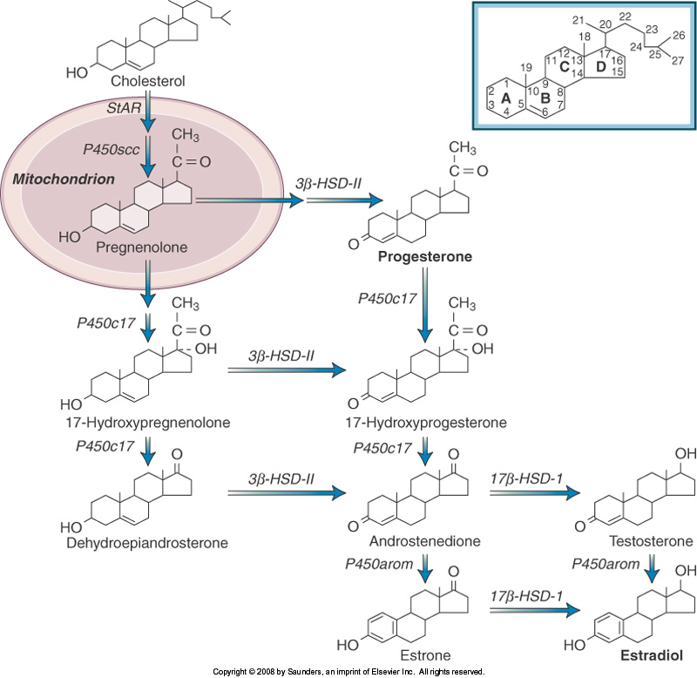
Notes:
Steroidogenetic pathways and bi-directional cross-talk between ovarian cells for fine paracrine and iuxtacrine modulation of their function

Slide 31
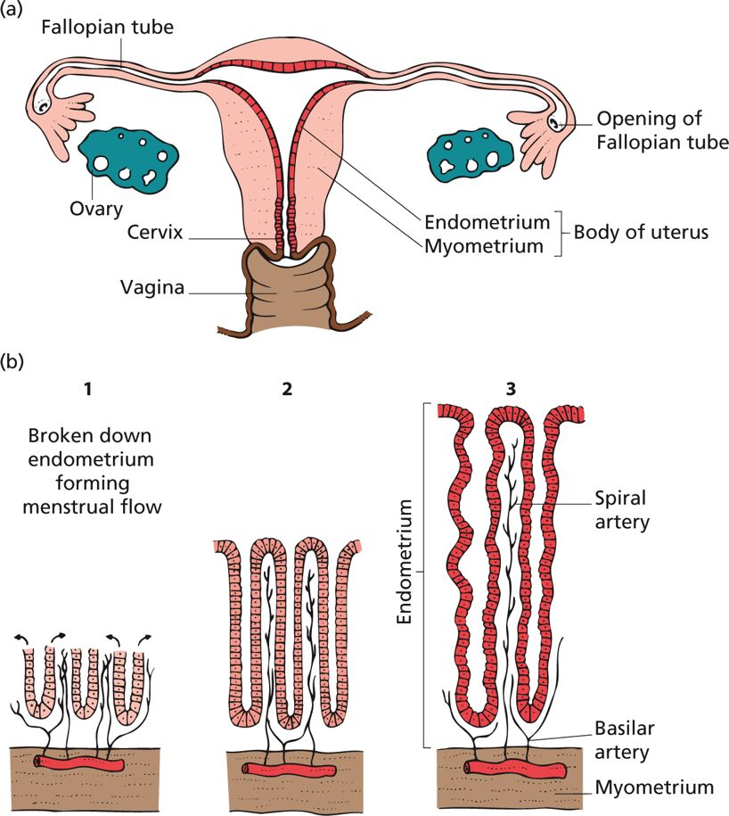
Changes in the uterine endometrium during the menstrual cycle.
The female reproductive organs. The body of the uterus consists of the inner endometrial layer and surrounding smooth muscle myometrium.
Uterine changes during the menstrual cycle. (1) Breakdown of the endometrium (days 1–3) when the outer two-thirds is shed to form the menstrual flow. The basal third of the endometrium persists and its cells divide and grow over the exposed tissue (arrows) to repair the endometrium. (2) During the oestrogenic proliferative phase (days 3–14), the uterine glands grow in length as the endometrium thickens. (3) During the secretory phase (days 14–28), uterine glands double in length and become tortuous and sacculated. Stromal oedema is maximal by day 21, the approximate time of blastocyst implantation. In the absence of pregnancy, during the last 2–3 days of this phase, the spiral blood vessels vasoconstrict and rupture. Lakes of blood form in the stromal tissue. Endometrial breakdown follows.
Notes:
If fertilization has occurred and a blastocyst has implanted (~day 20 of the menstrual cycle), the resulting embryonic trophoblast begins to secrete hCG, a glycoprotein hormone that acts like LH at the LH receptor. hCG maintains the corpus luteum and, in the face of continuing oestradiol and progesterone, menstruation is postponed.

Slide 32
Endocrine alterations during pregnancy, parturition and lactation
Pregnancy
Maternal:
Hypertrophy/hyperplasia of lactotrophs synthesizing prolactin
hCG (partially mimics TSH) stimulation of thyroid hormone synthesis
Increased β-cell function and potential growth of pancreatic islets
Increased adrenal cortisol output
Increased heart rate; cardiac output rises by 30–50% because of alterations in the hormonal milieu and placental circulation
Fetal growth and development:
◦ Requires thyroid hormone (CNS development), insulin and GH–IGF axes
◦ Maturation of the fetal lung (surfactant production) by cortisol near term
Parturition
Local prostaglandins stimulate the early uterine contractions
Oxytocin increases as the fetus descends the birth canal and distends the vagina
Lactation
• High oestrogen and progesterone during pregnancy inhibit lactation
• Post-partum, lactation relies on continued prolactin and cortisol
• Oxytocin, released via the suckling reflex, stimulates milk ejection

Slide 33
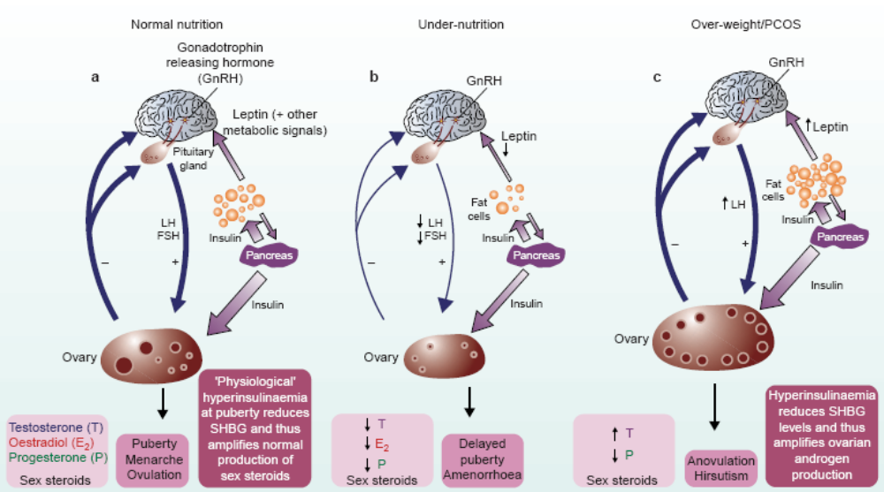
Relationships between metabolic factors and reproduction

Slide 34
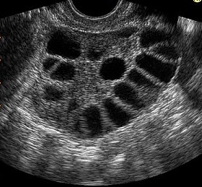
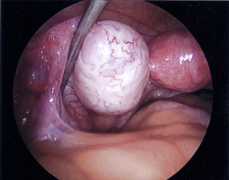
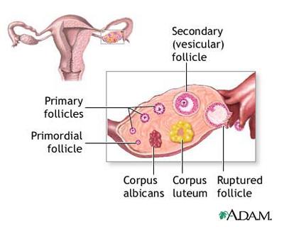
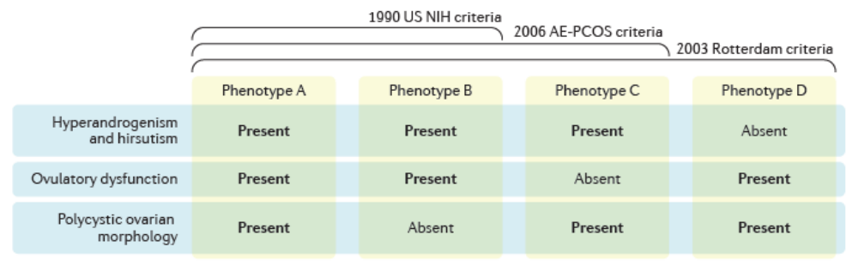
Polycystic Ovary Syndrome
Notes:
Diagnostic criteria and phenotypes of PCOS. Polycystic ovary syndrome (PCOS) is classified into four separate phenotypes (A–D), according to the presence or absence of three characteristics: hyperandrogenism (either biochemical or clinical), ovulatory dysfunction and polycystic ovarian morphology. Only phenotype A requires all three features of PCOS to be present. The various diagnostic criteria currently available for PCOS include a greater or fewer number of PCOS phenotypes. AE-PCOS, Androgen Excess-PCOS Society; NIH, National Institutes of Health.

Slide 35
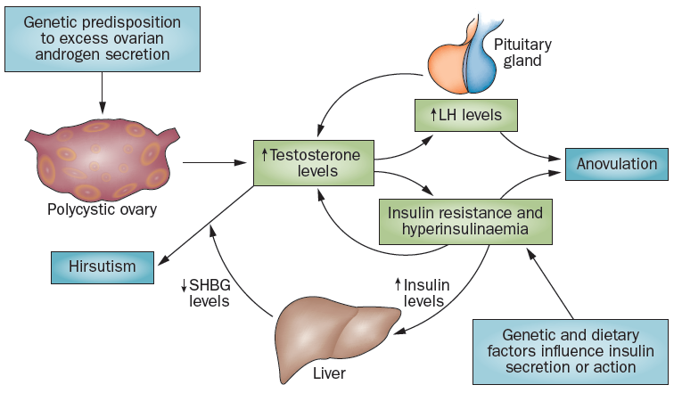
Pathogenesis of PCOS

Slide 36
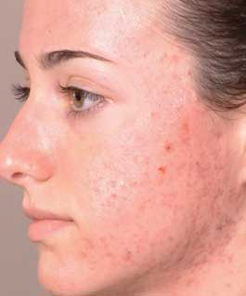

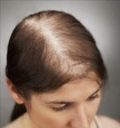
Androgen Excess Syndrome in PCOS
Acne
Hirsutism
Androgenic alopecia

