Slide 1
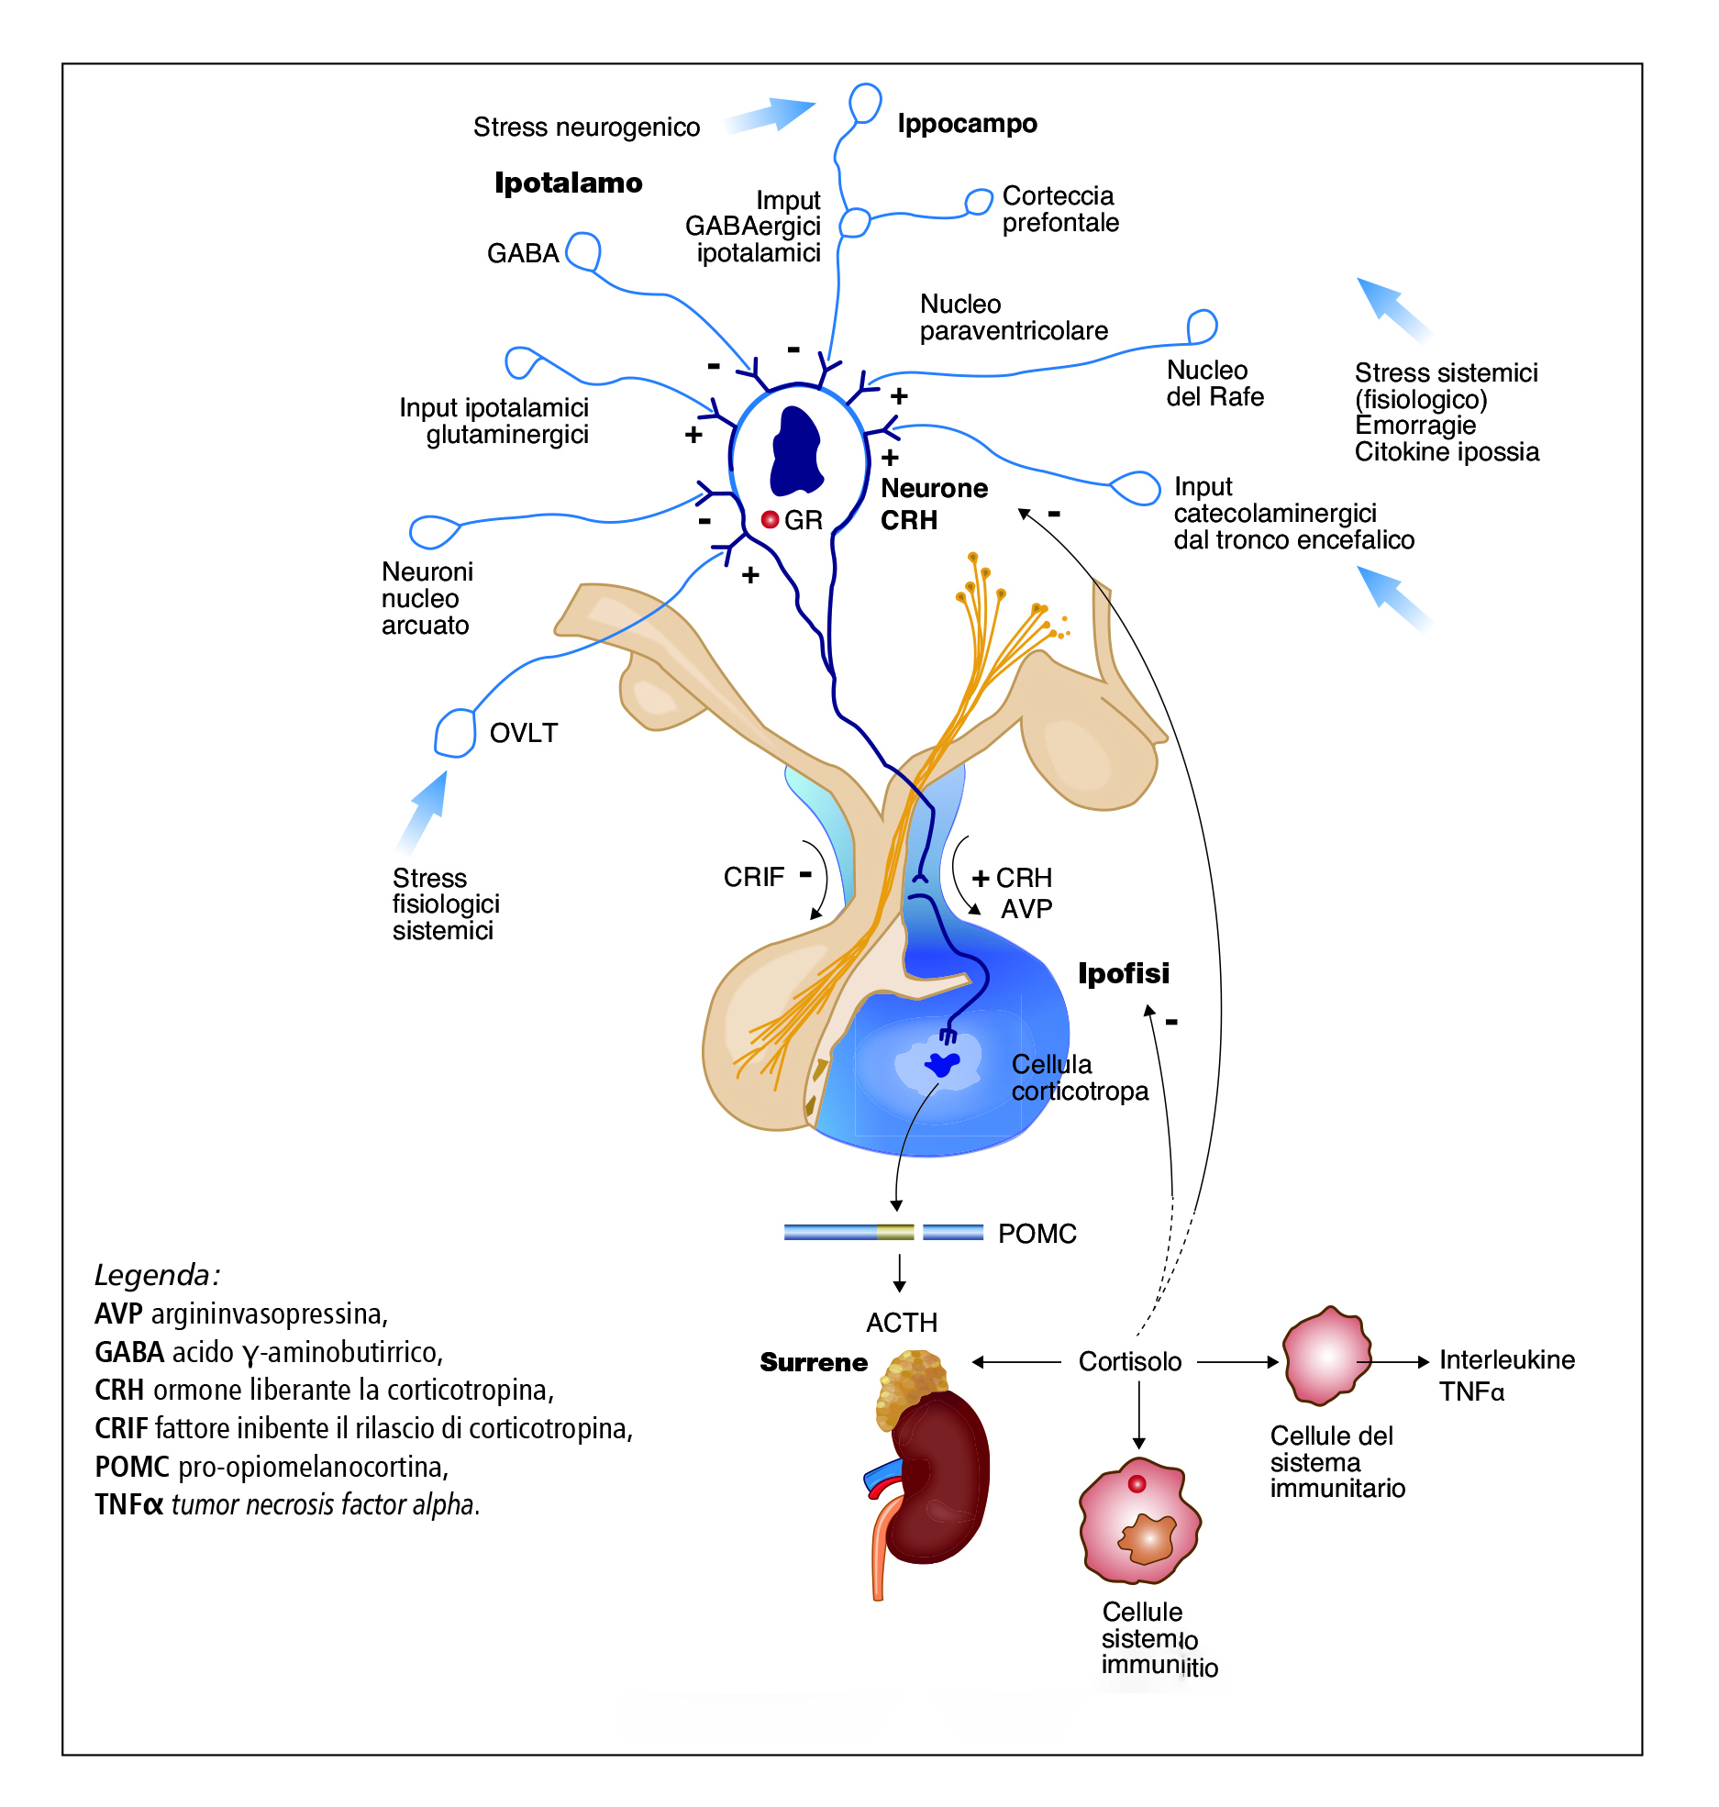

Slide 2
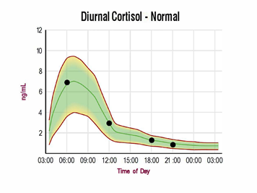
Under normal conditions the secretion of CRH, AVP, ACTH and Cortisol follows a pulsatile, circadian rhythm with increased amplitude and frequency of the secretory pulses in the early morning

Slide 3
The Stress System

Slide 4
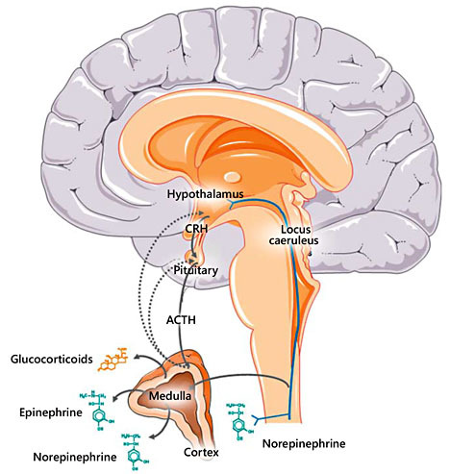
Human organisms have to cope with a large number of external or internal stressful stimuli (stressors) that threaten – or are perceived as threatening – their internal dynamic balance (the homeostasis) activating an adaptive response
Notes:
Central and peripheral components of the stress system : interrelations between CNS pathways involved in stress response and endocrine system. The stress system is activated through a syncronized interplay between the hypothalamic-pituitary adrenal axis and locus caeruleus (LC)/norepinephrine (NE) autonomic nervous system

Slide 5
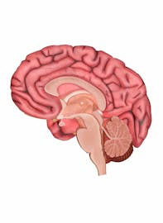
Stressor
Central Component
Peripheral Component
Parvocellular CRH and AVP neurons of the paraventricular nuclei of the hypothalamus
CRH neurons of the paragigantocellular and parabrachial nuclei
Noradrenergic LC nuclei in the medulla and pons
Hypothalamic pituitary adrenal axis
Efferent systemic sympathetic and adrenomedullarysystems (SNS)
Parasympathetic nervous system

Slide 6
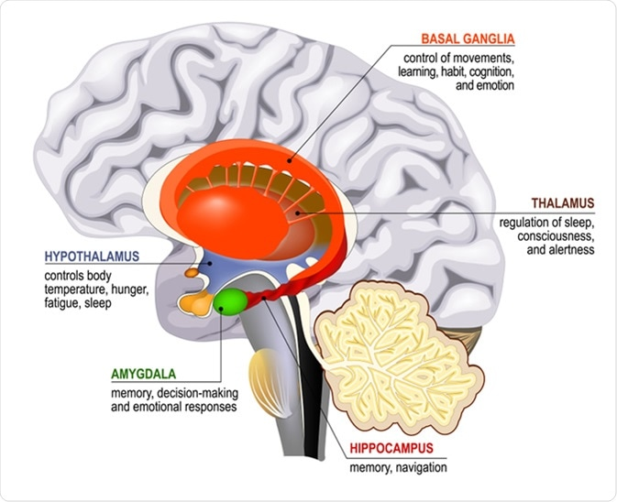
Hippocampus is a brain structure embedded deep in the temporal lobe of the cerebral cortex. It is an important part of the limbic system, a cortical region that regulates motivation, emotion, learning, and memory
Activatory effect
CRH/AVP
LC/NE neurons
POMC
Dopaminergic system
Inhibitory effect

Slide 7
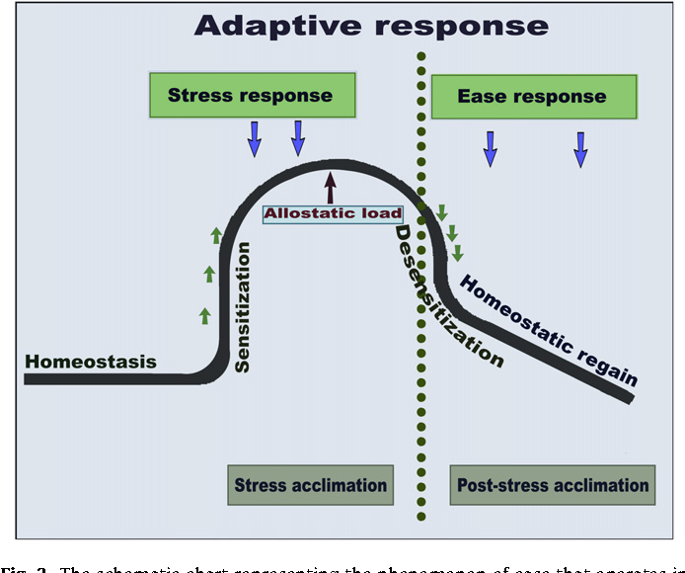
In excess of stressors, the stress system receives and processes them to achieve short-term physical and behavioral alterations to resume homeostasis
Stress syndrome - the adaptive response
Body's ability to cope with stress in a healthy way that promotes well-being and resilience, involving physiological, psychological, and behavioral reactions that help return the body to balance. This is different from a maladaptive response, which can lead to long-term health problems. Developing adaptive responses can involve both innate biological mechanisms and learned coping strategies, like regular exercise and mindfulness.

Slide 8
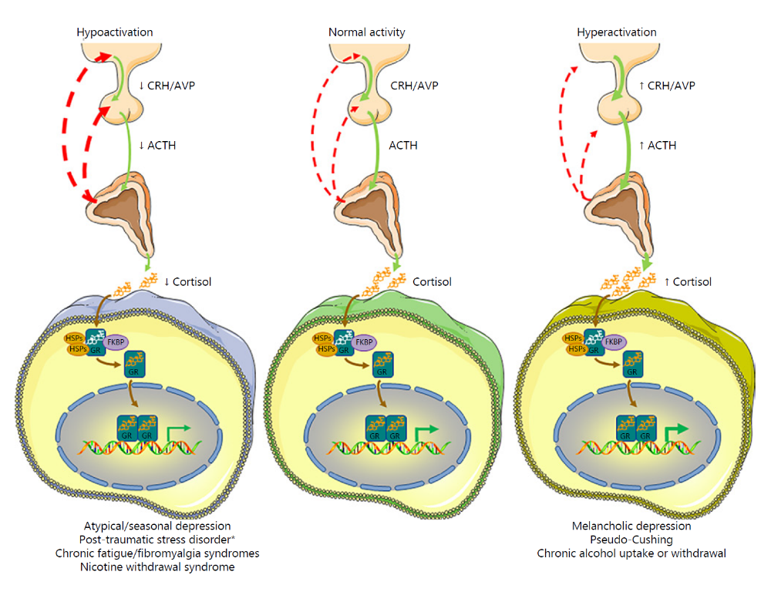
Notes:
Pathophysiology of hypoactivation and hyperactivation of the HPA axis. Hypoactivation of the HPA axis has been associated with atypical/seasonal depression, adult post-traumatic stress disorder*, chronic fatigue/fibromyalgia syndromes, and nicotine withdrawal syndrome. On the other hand, hyperactivation of the HPA axis has been linked to melancholic depression, pseudoCushing syndrome, and chronic alcohol uptake and withdrawal. ACTH, adrenocorticotropic hormone; AVP, arginine vasopressin; CRH, corticotropin-releasing hormone; FKBP, immunophilin; GR, glucocorticoid receptor; HSP, heat shock proteins. *In the case of adult PTSD, low cortisol concentrations are paradoxically associated with increased CRH secretion and LC/NE-ANS activation. Activation is represented by solid green lines and inhibition by dashed red lines.

Slide 9
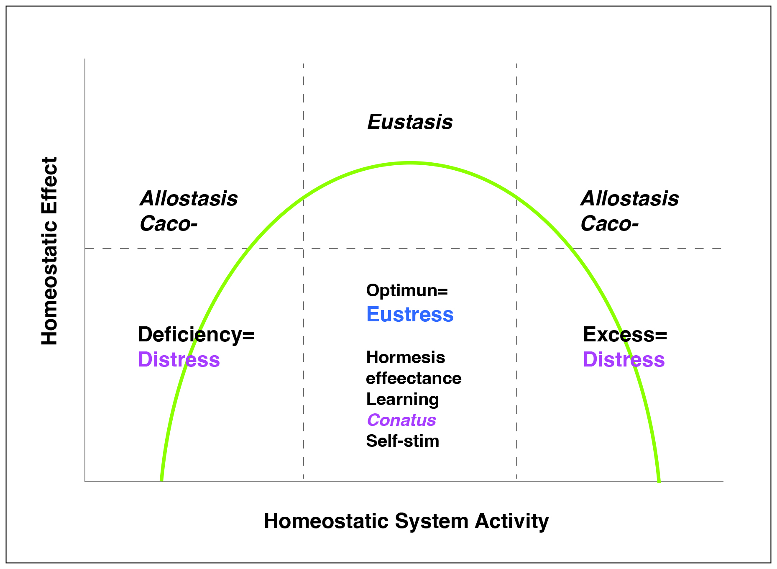

Slide 10
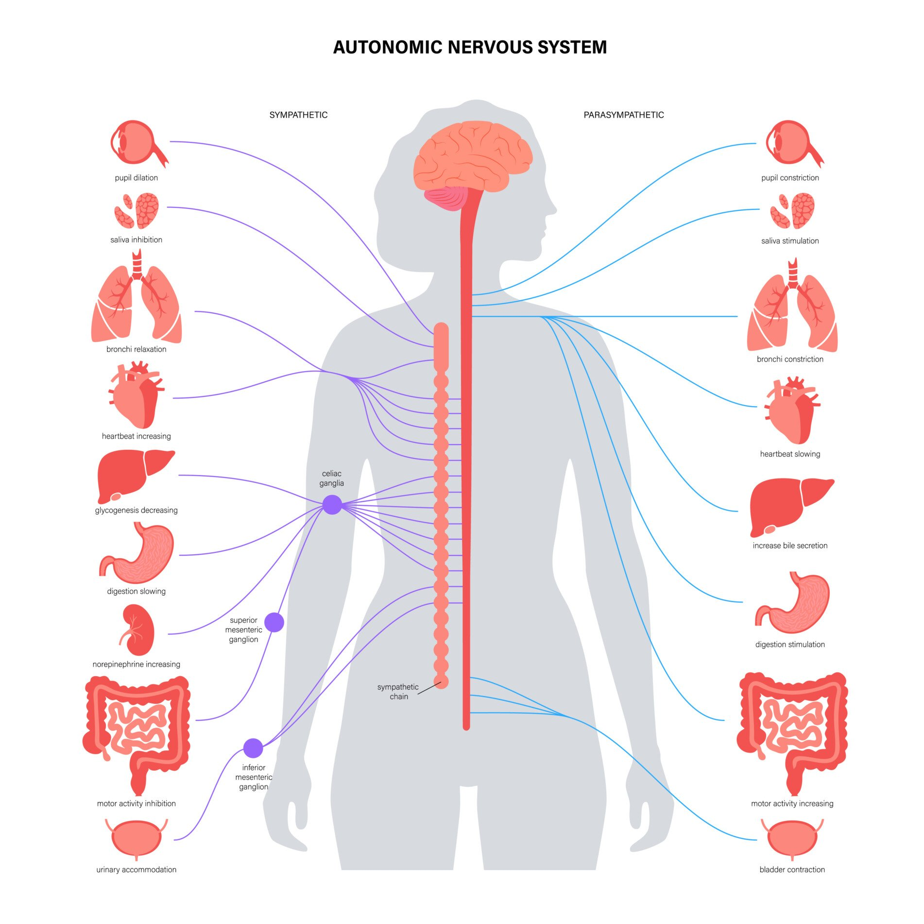
Notes:
Autonomic

Slide 11
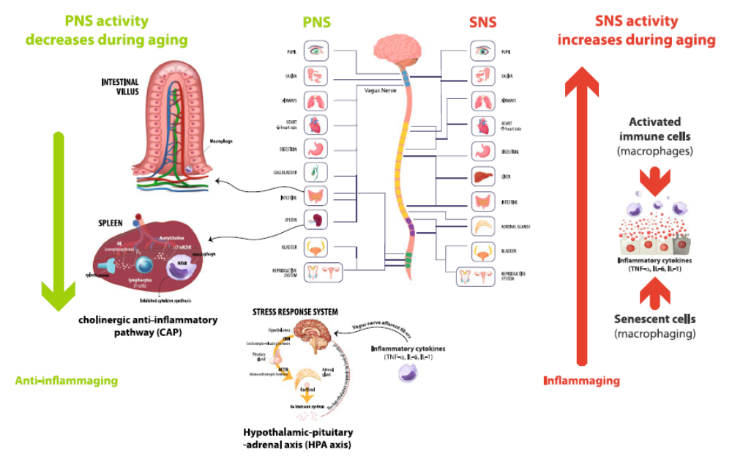
Notes:
PNS (parasympathetic nervous system, the network of nerves and ganglia outside the brain and spinal cord that connects the central nervous system (CNS) to the rest of the body) and SNS (sympathetic nervous system the part of the autonomic nervous system that triggers the "fight-or-flight" response, preparing the body for stress or action) play key activities and relevant age-related changes potentially associated with modulation of inflammaging. PNS and SNS key activities are depicted schematically. HPA and CAP can be stimulated by vagus nerve, acting as anti-inflammatory pathways. In the CAP, the vagus nerve acts in synergy, through the splenic nerve, to inhibit the release of TNFα by macrophages of the spleen. It was recently suggested also a gastrointestinal CAP. Vagus nerve trough afferent fibers senses inflammatory molecules, i.e., cytokines, and transmits signals to the hypothalamus causing the release of CRH inducing then release of ACTH into the systemic circulation, whereby it promotes synthesis and secretion of glucocorticoids at the adrenal cortex. Glucocorticoids are then secreted into the systemic circulation and can access cognate receptors in different organs, including the brain. Reduced HPA and CAP activity during aging can contribute to reduce anti-inflammaging strategies. SNS overflow reported during aging could contribute to fuel inflammaging, acting synergistically with the cellular and molecular culprits of inflammaging, i.e., increased burden of activated immune cells (mainly macrophages) and increased burden of senescent cells (including macrophages).
SNS, sympathetic nervous system; PNS, parasympathetic nervous system; HPA axis, hypothalamic pituitary adrenal axis; CAP, cholinergic anti-inflammatory pathway; ACTH, adrenocorticotrophic hormone; CRH, corticotropin releasing hormone; TNFα, tumor necrosis factor-alpha

